Slide 1
LAB 04 – AWS
Task 01:
Implement a vpc with cidr 10.0.0.0/16 with 2 public subnets with cidrs 10.0.0.0/24 and 10.0.0.2.0/24 with a load balancer to Distribute the traffic between 2 machines with nginx installed in them as a proxy and 2 private subnets with the below cidrs 10.0.1.0/24 and 10.0.0.3.0/24 then a 2 instances attached in autoscaling in the private subnets with apache installed without SSH and load balancer to install between them.
Needed:
A screenshot from the autoscaling group after indicating the minimum, maximum and desired instances.
Screenshot from the 2 target groups indicating the machines is healthy.
Screenshot indicate the machines BE WS are private.
Screenshot from the public load balancer when you hit a request from it from a browser with a response returned from the instances.

Slide 2
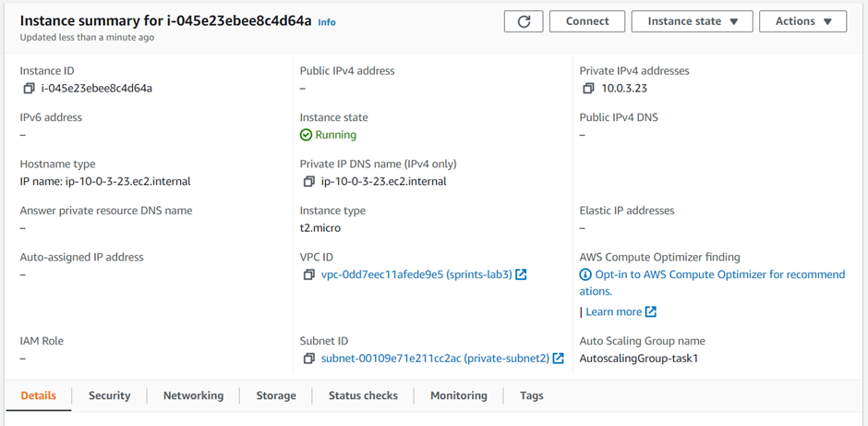
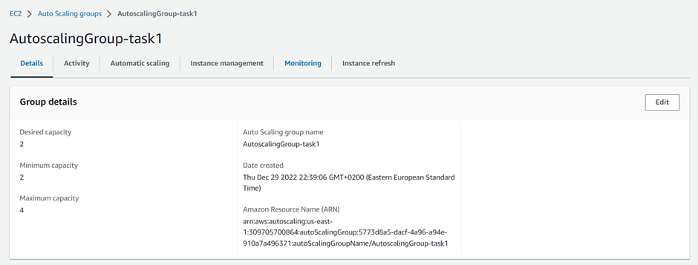
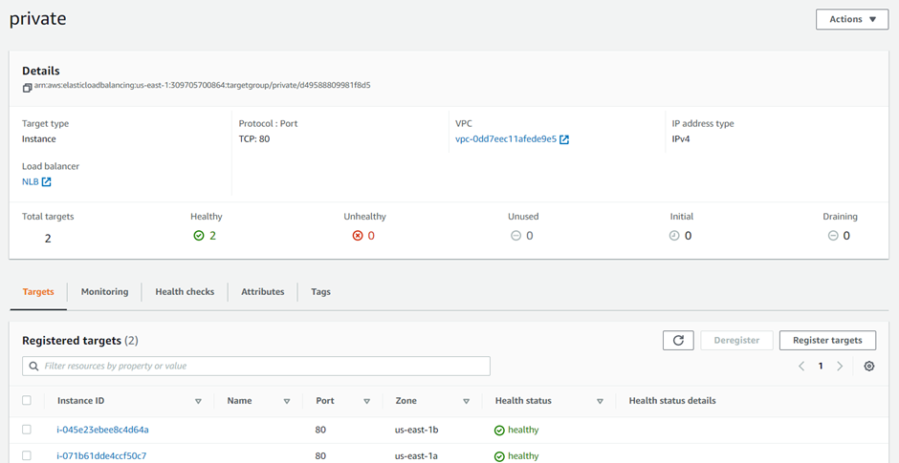
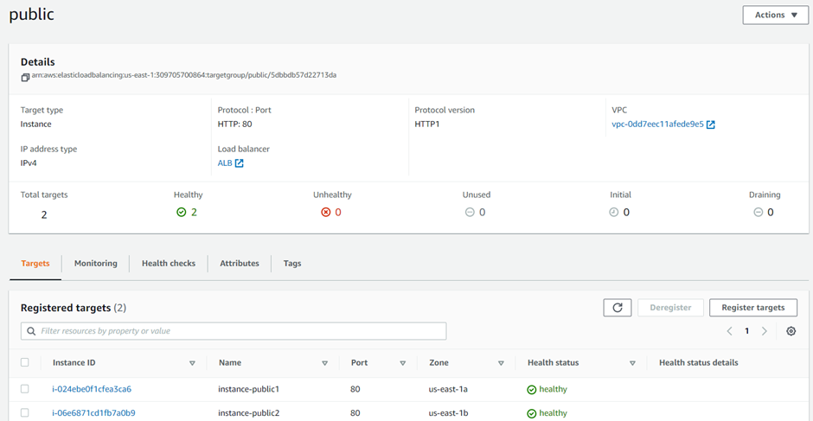

Slide 3
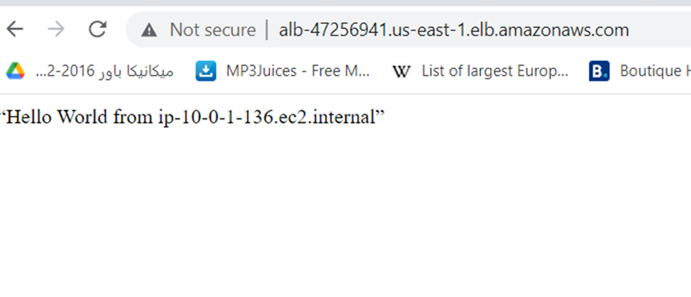
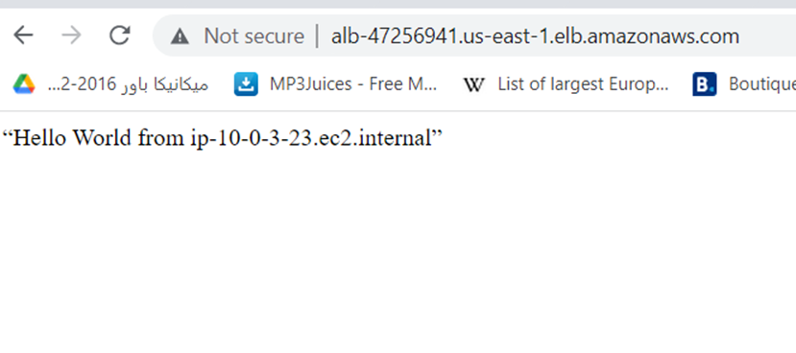

Slide 4
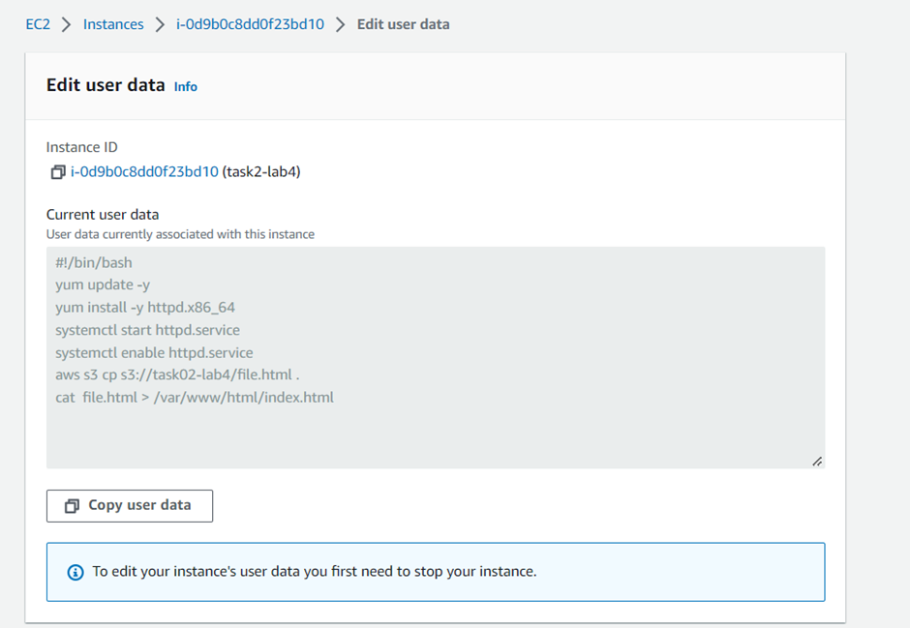
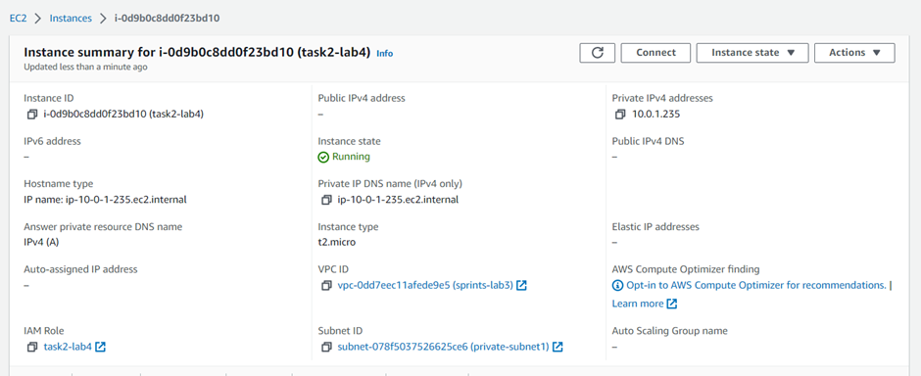
Task 02:
Create a vpc with cidr 10.0.0.0/16 with private subnet and a machine in it with apache installed without ssh ,also we need to serve an application from S3 bucket .
Needed:
Screenshot from the user data.
Screenshot from the logs of the instance.
Screenshot indicate the machine is private.

Slide 5
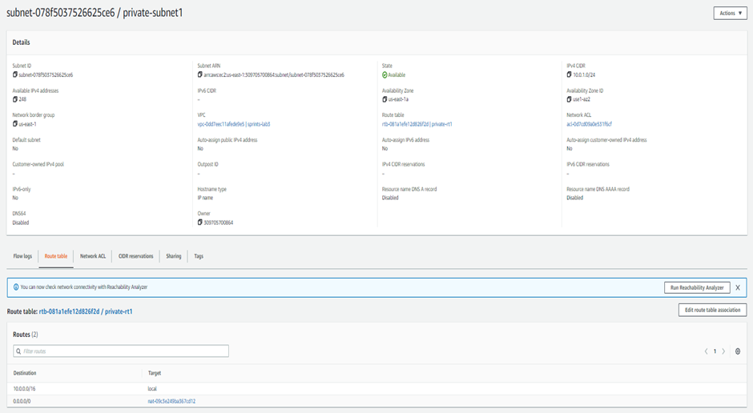
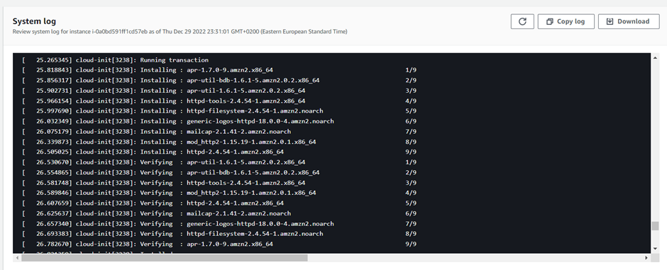
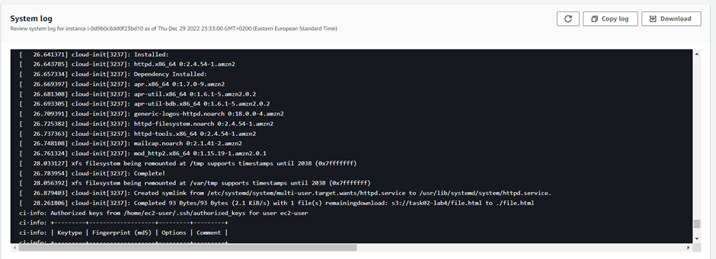

Slide 6
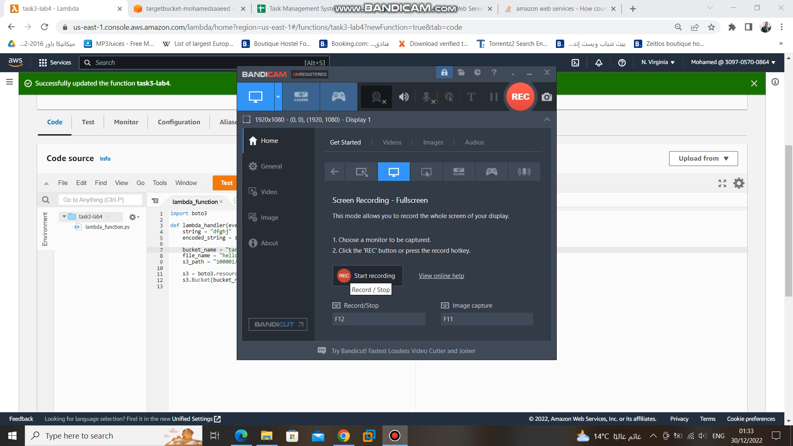
Task 03:
Create a lambda function to copy a text file to an s3 called targetBucket-yourname (search for the code)
Needed a video while triggering the lambda

Slide 7
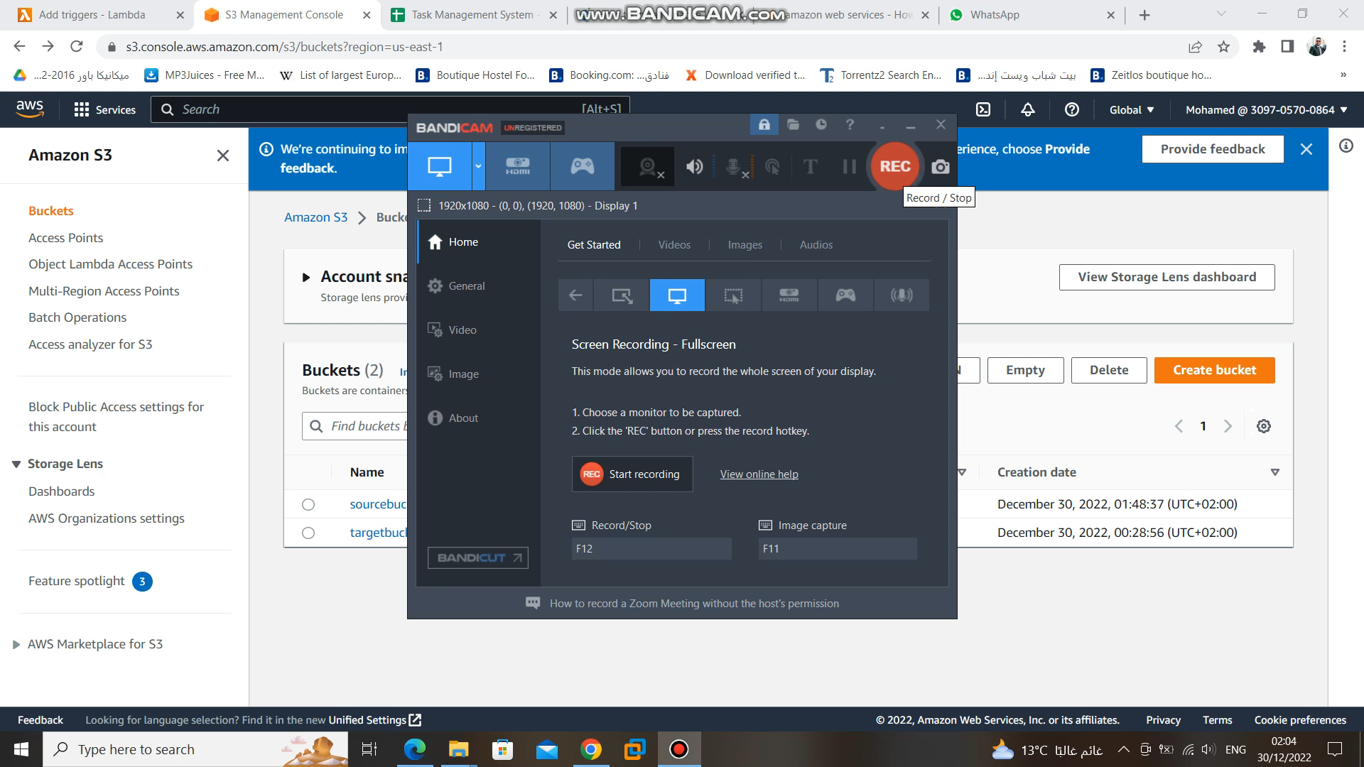
Task 04:
Create a lambda function to be triggered when you upload a file to s3 called sourcebucketyourname , the lambda will copy the uploaded file to an s3 with name target-bucket-yourname
Needed a video while triggering the lambda

